Slide 1
Data Mining, Big Data and Data Analytics Project Presentation - UK Traffic Accidents (2005-2014)
Presented by:
Dina Walid
Nariman Reda
Ahmed Ashraf
Yasmine Hatem
Presentation date: 02/05/2020

Slide 2
Agenda
Introduction
Applications
Data visualization and data insights
Dataset
Data pre-processing
Time series model
Severity prediction model

Slide 3
Introduction
Road accidents are a major and growing cause of death, injury and loss of money. So, investigating accidents is a must. This project aims to study accidents in UK over ten years, which would help in numerous applications.

Slide 4
Applications
Predicting the number of accidents that would happen in the next few years, we can use this prediction to compare with the actual number of accidents and check if there is a significant increase which will show us that we have a problem.
Predicting severity of the accident based on some attributes, which would help in deciding how many ambulances to send to the accident location for example.

Slide 5
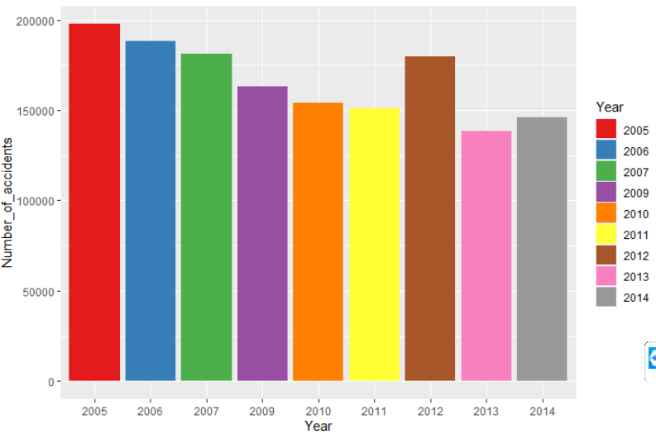
Data visualization and insights
Year 2005 had the highest number of accidents then it gradually decreased but had an increase in 2012 then continued decreasing gradually again.
Number of accidents
over years

Slide 6
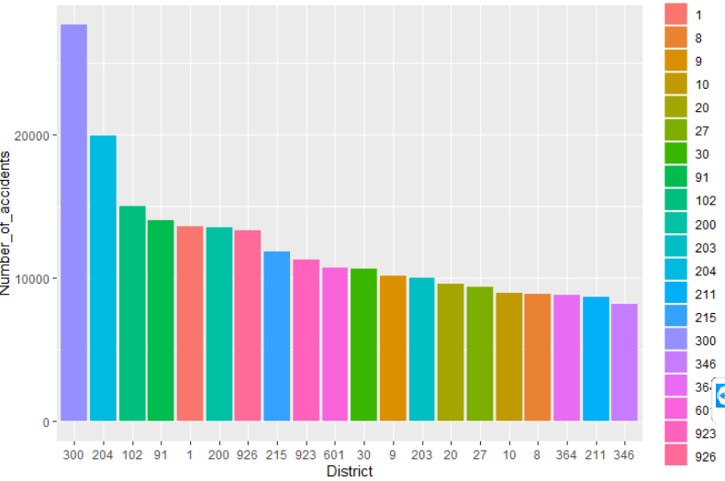
Data visualization and insights
District 300 has the highest number of accidents, it is almost two times any of the 20 most frequent districts.
The most frequent 20 districts must be studied deeper to know the causes of their high number of accidents and try to control this problem.
Number of accidents in
top 20 districts

Slide 7
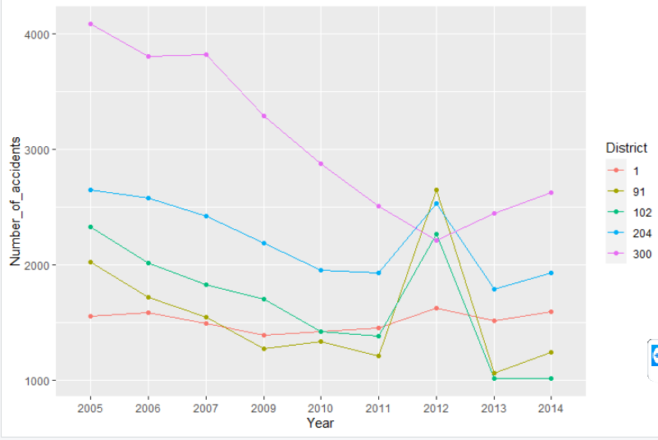
Data visualization and insights
By investigating over years, it is seen that district 300 had very high number of accidents till 2007 then the number started to decrease since then, then it became stable, so obviously there was a problem that was solved by 2007.
By observing the most frequent 5 districts over year, most of the districts had a peak in 2012.
Number of accidents in top
5 districts over years

Slide 8
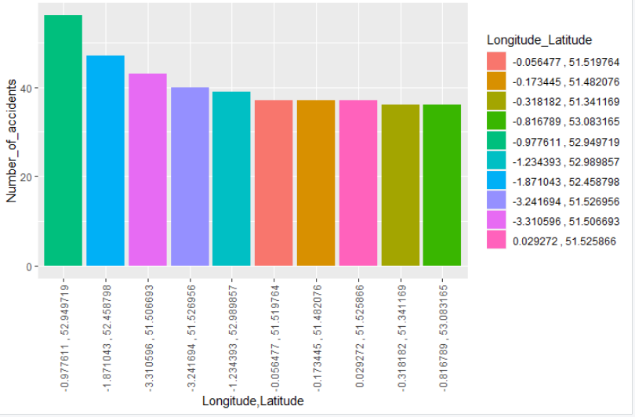
Data visualization and insights
Top 10 frequent locations have to be maintained quickly to stop accidents from happening again there, for example the first one had about 70 accidents which is a suspicious number, so it may have infrastructure problems.
Top 10 frequent locations

Slide 9
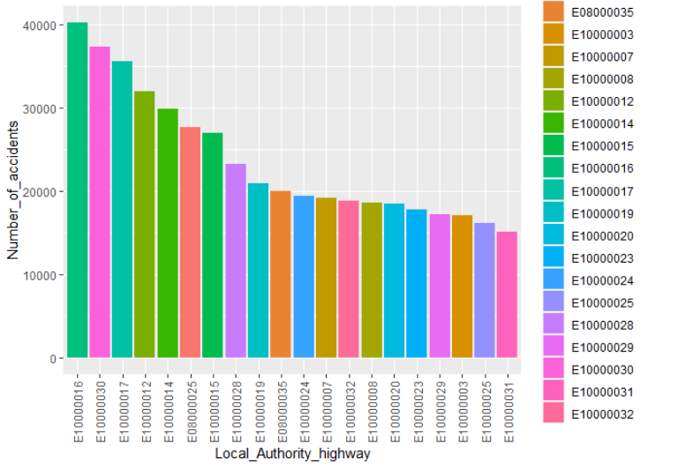
Data visualization and insights
Local Authority (Highway) is the council responsible of maintaining and protecting public rights of way. The shown most frequent 20 authorities must be asked for maintaining those roads.
Number of accidents of each local authority(Highway) that have the duty of maintaining the roads “Showing only the most frequent 20”

Slide 10
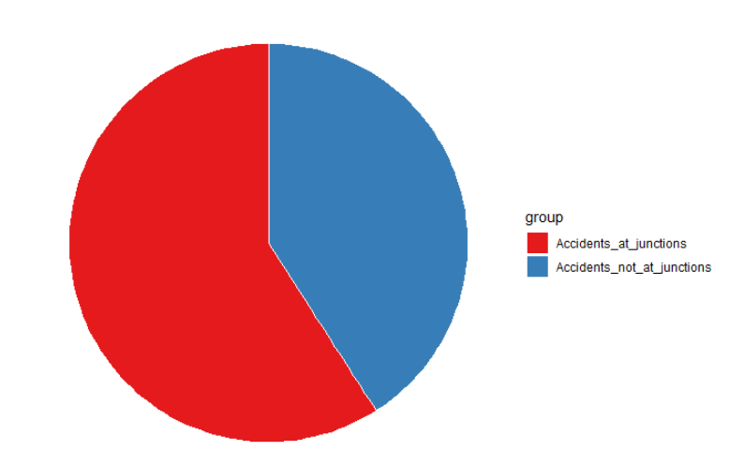
Data visualization and insights
Accidents happen at junctions more often than accidents not at junctions especially for junctions that are uncontrolled.
Accidents at junctions vs Accidents not at junctions

Slide 11
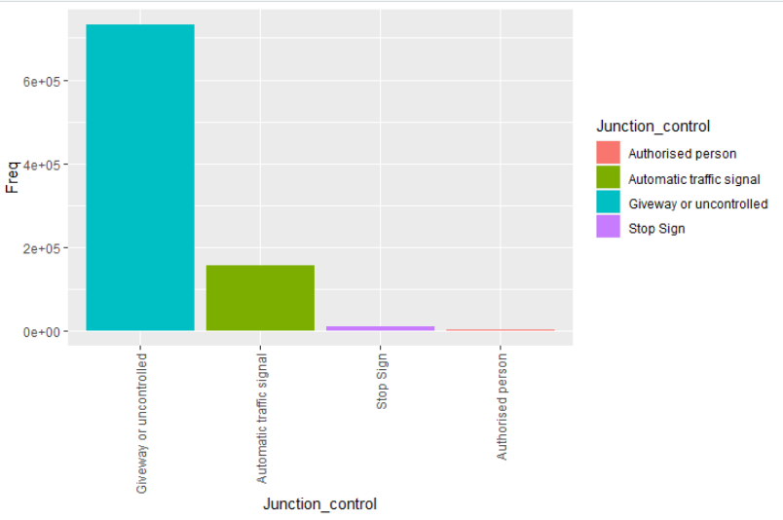
Data visualization and insights
Junctions have to be controlled to avoid accidents, by observing from dataset the junctions controlled by authorized person have the least number of accidents. There is a significant difference between it and automatic traffic signals.
Relationship between junction control and number of accidents

Slide 12
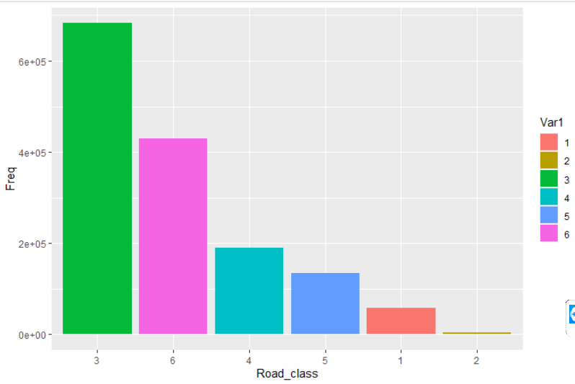
Data visualization and insights
Road class 3 has the highest number of accidents followed by 6, but 1, 2, 4, 5 have significantly less number of accidents than both of them.
Relationship between road
class and number of accidents

Slide 13
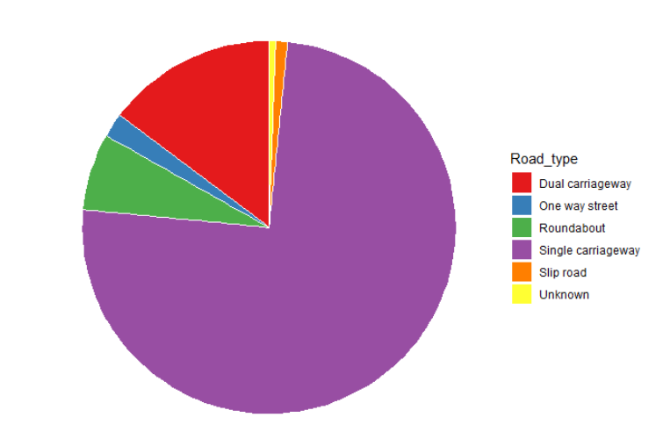
Data visualization and insights
Road type of single carriageway which is undivided highway with two or more lanes has the highest percentage of accidents (almost 80%) which makes sense as it has to be separated and controlled.
Percentage of each road type in accidents

Slide 14
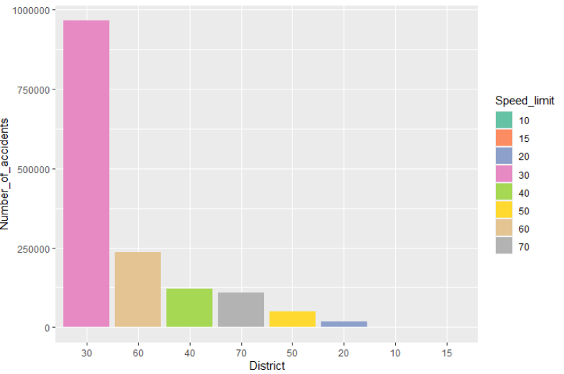
Data visualization and insights
Most of the accidents happen in regions of speed limit 30.
Relationship between speed limit and number of accidents

Slide 15
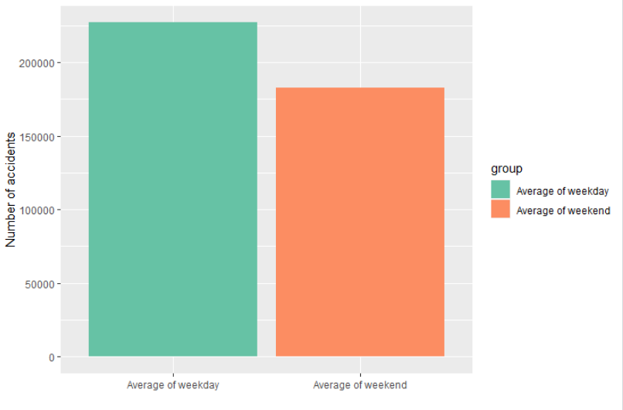
Data visualization and insights
Average number of accidents in weekdays is less than in weekends. This is due to the high traffic.
Average of weekday vs Average
of weekend

Slide 16
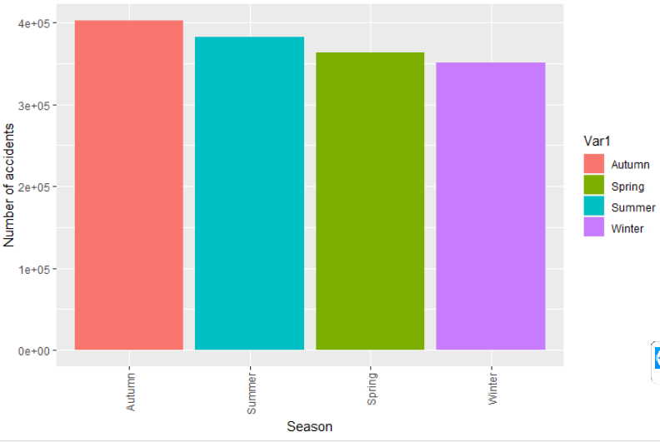
Data visualization and insights
Autumn has the highest number of accidents because of wind and storms, so a solution like Windbreaks must be held.
Relationship between number of accidents and seasons

Slide 17
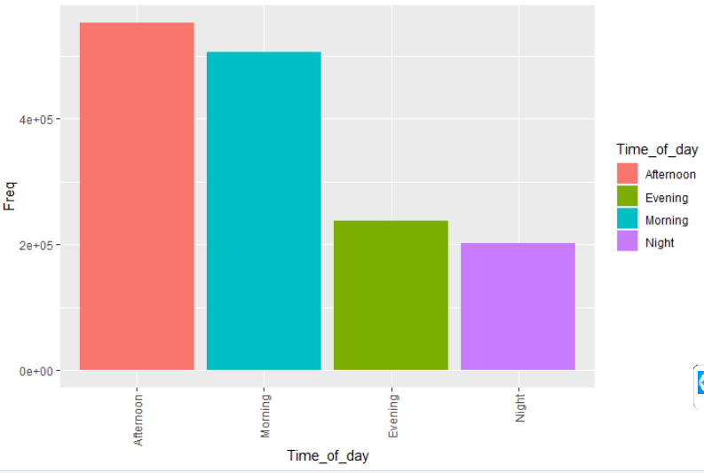
Data visualization and insights
Most of the accidents happen in Afternoon that includes rush hour, followed by Morning but Evening and Night are significantly less than them.
Relationship between number of
accidents and time of day

Slide 18
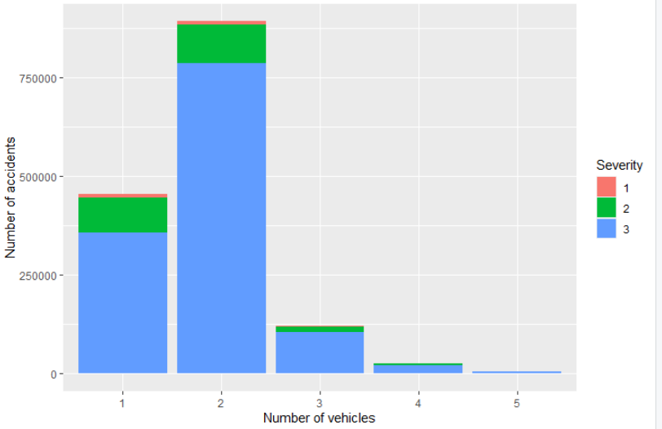
Data visualization and insights
Severity 3 accidents are the most common.
Most of the accidents happen between 2 vehicles. These accidents are often of severity 3.
Accidents between more than 3 vehicles rarely happen.
Relationship between number of vehicles, severity and number of accidents

Slide 19
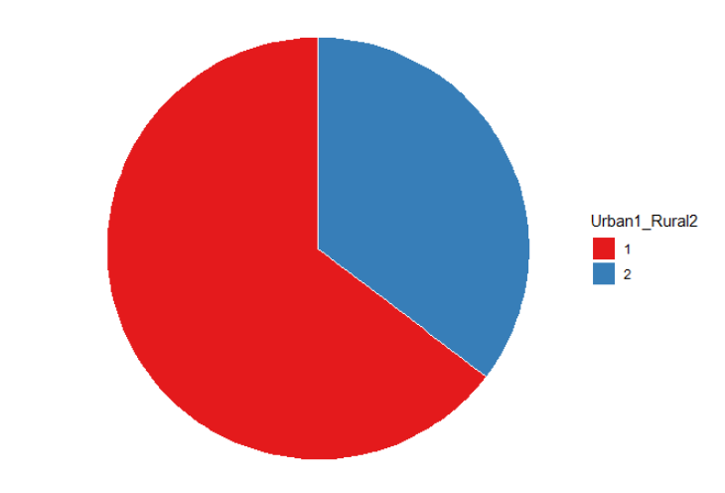
Data visualization and insights
Almost 75% of the accidents happen in Urban areas.
Number of accidents in urban
areas vs Number of accidents in rural areas

Slide 20
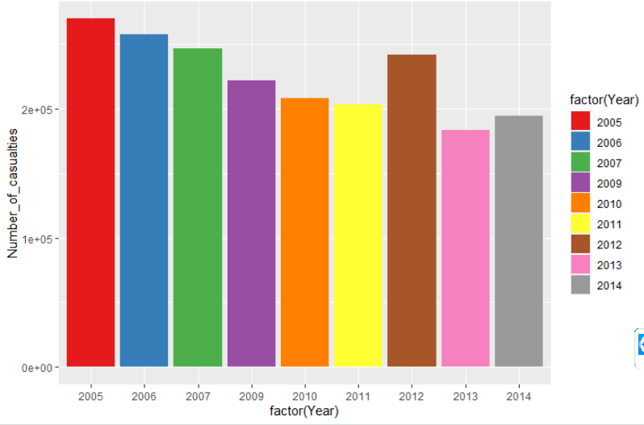
Data visualization and insights
Number of casualties is decreasing gradually over years, it had only a slight increase in 2012 then continued decreasing.
Number of casualties over years

Slide 21
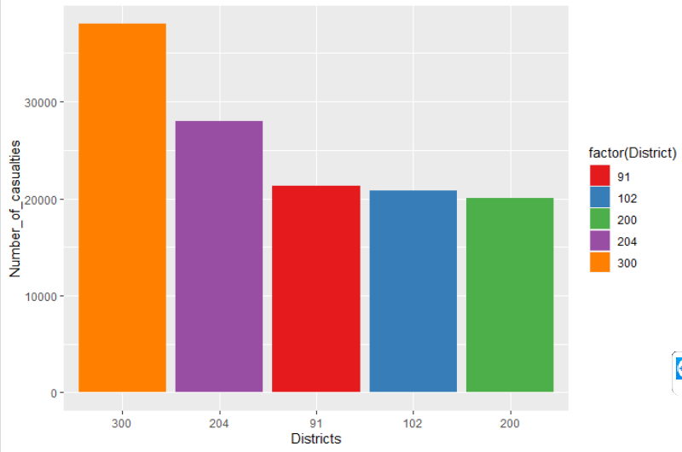
Data visualization and insights
District 300 has the highest number of casualties.
Top 5 districts in number of casualties

Slide 22
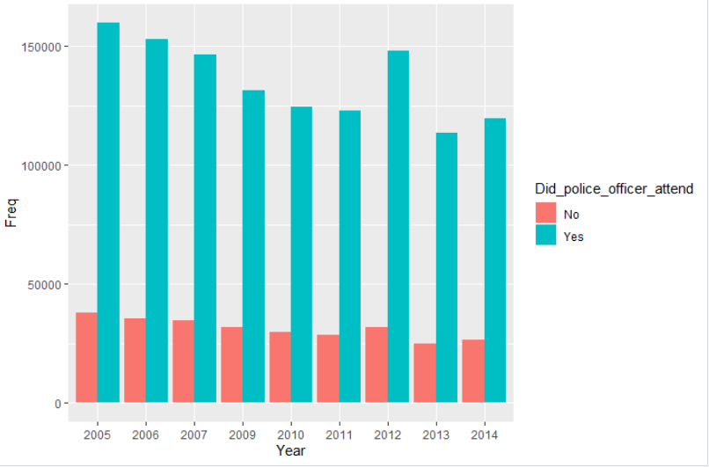
Data visualization and insights
Police attendance to scene of accidents is decreasing over years.
"Did police officer attend the scene of the accident" over years

Slide 23
Dataset
The UK government collected traffic data, recording over 1.6 million accidents in the process and making this one of the most comprehensive traffic data sets out there. The data files together constitute 1.6 million traffic accidents. The total time period is 2005 through 2014, but 2008 is missing.
Dataset columns
1) Accident_Index | 12) Time | 23) Pedestrian_Crossing-Human_Control
2) Location_Easting_OSGR | 13) Local_Authority_(District) | 24) Pedestrian_Crossing-Physical_Facilities
3) Location_Northing_OSGR | 14) Local_Authority_(Highway) | 25) Light_Conditions
4) Longitude | 15) 1st_Road_Class | 26) Weather_Conditions
5) Latitude | 16) 1st_Road_Number | 27) Road_Surface_Conditions
6) Police_Force | 17) Road_Type | 28) Special_Conditions_at_Site
7) Accident_Severity | 18) Speed_limit | 29) Carriageway_Hazards
8) Number_of_Vehicles | 19) Junction_Detail | 30) Urban_or_Rural_Area
9) Number_of_Casualties | 20) Junction_Control | 31)Did_Police_Officer_Attend_Scene_of_Accident
10) Date | 21) 2nd_Road_Class | 32) LSOA_of_Accident_Location
11) Day_of_Week | 22) 2nd_Road_Number | 33) Year

Slide 24
Data pre-processing
Pre-processing the data went through the following steps:
Removing of useless columns that will not affect our insights or models:
a) Accident_index
b) Location_Easting_OSGR
c) Location_Northing_OSGR
We removed (b,c) as we used Latitude and Longitude columns of dataset instead.
Removing of columns that we searched a lot and did not understand what they refer to:
a) Police_Force
b) LSOA_of_Accident_Location
Removing of column that had no value for any row:
a) Junction_Detail

Slide 25
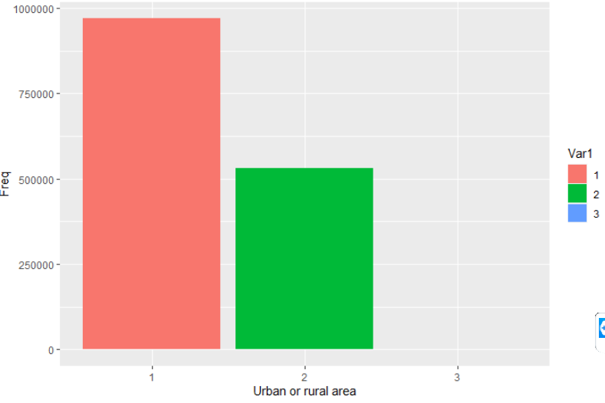
Data pre-processing
Removing of rows that had missing values.
Removing of outliers:
For example, in Urban or Rural column, it had to be 1 for Urban or 2 for Rural but some rows had value of 3, so we removed all rows of value 3 which were only 35/1.6 million records.

Slide 26
Data pre-processing
Categorizing time.
Categorizing months.
Morning | 6:00 - 12:00
Afternoon | 12:00 – 17:00
Evening | 17:00 – 20:00
Night | 20:00 - 6:00
Spring | 3 – 5
Summer | 6 - 8
Autumn | 9 – 11
Winter | 12 – 2

Slide 27
Data pre-processing
Pre-processing related to time series analysis model:
Creating a new sorted data frame containing only:
Month, Year and Number of accidents.
Dividing dataset into training set and test set:
Training set: 2005 – 2011 (1,000,000 records)
Test set: 2012 – 2015 (500,000 records)

Slide 28
Data pre-processing
Pre-processing related to severity prediction model:
Dividing dataset into training set and test set:
Training set: 75% of dataset.
Test set: 25% of dataset.
Fixing unbalanced training set problem:
The dataset was biased to severity 3, almost 90% of training set. So, this was solved by deleting random rows of severity 3.

Slide 29
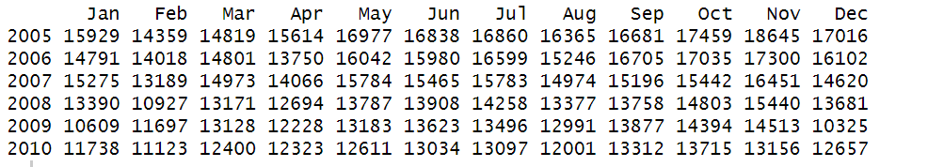
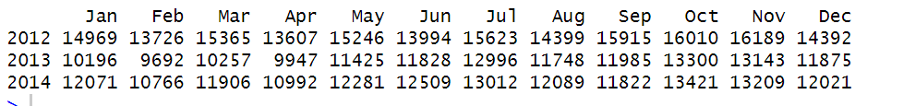
Time series model
This model will predict the number of accidents in the next few months.
Time series objects:
Training set time series object:
Test set time series object:

Slide 30
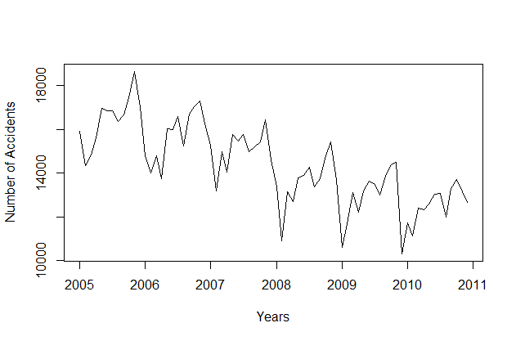
Time series model
Data visualization:
Training set:
As observed from this plot, both mean and variance are not constant over years.

Slide 31
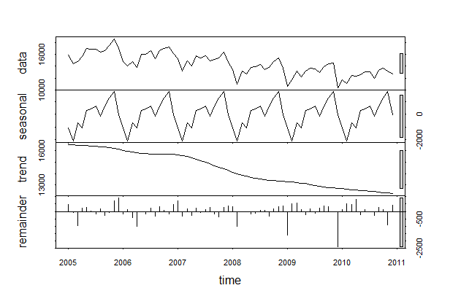
Time series model
Time series components:
As observed from this plot, there is linear trend as generally it’s decreasing linearly and seasonality as the pattern repeats itself each year.

Slide 32
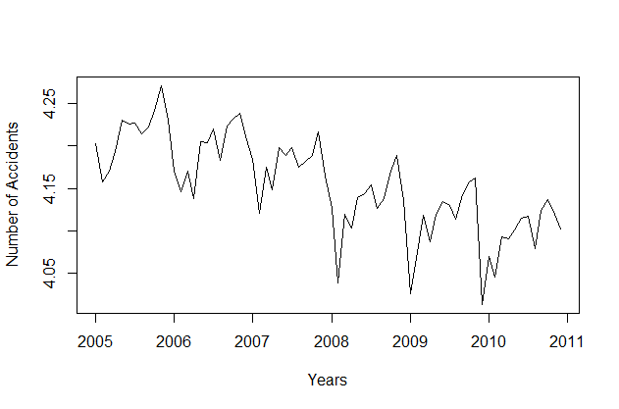
Time series model
After applying the Logarithmic transformation:
The variance becomes constant over years.

Slide 33
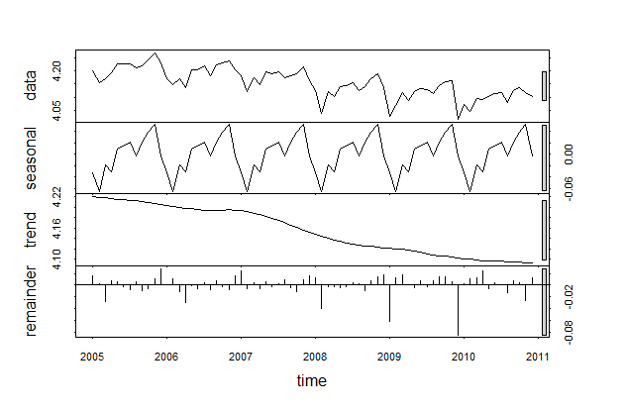
Time series model
Time series components after applying Logarithmic transformation:

Slide 34
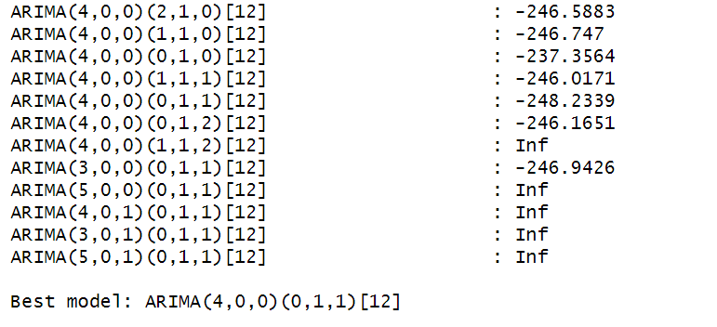
Time series model
Model building:
The model used is ARIMA model. We will pass to the model the data after applying logarithmic transformation only, and the model will internally handle the de-trending to have constant mean and seasonal adjustment to eliminate seasonality.
So, the best candidate is:
(4,0,0): non-seasonal part (p, d, q)
(0,1,1) [12]: seasonal part [P, D, Q] [S]

Slide 35
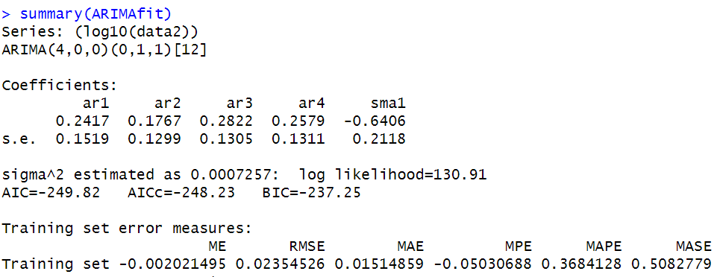
Time series model
Model training:
By evaluating this model, it was found to be good as the measured error is so small.

Slide 36
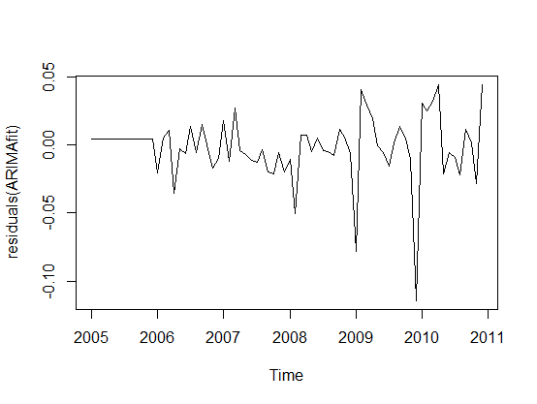
Time series model
Model evaluation:
On Training set:
Model accuracy on training set:
Model residuals:
(This represents the difference between the actual training points and the corresponding fitted values)

Slide 37
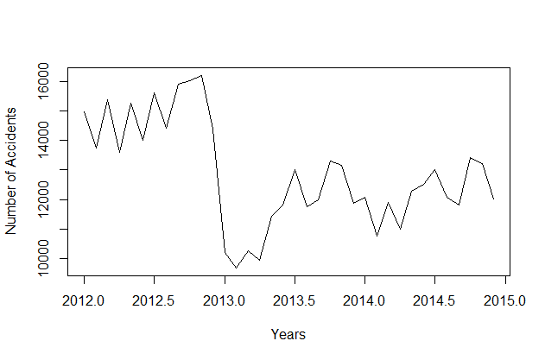
Time series model
Model evaluation:
On Test set:
Test set:
We can clearly notice that 2012 has extremely high number of accidents compared to 2013 and 2014. So, we will have a huge drop between 2012 and 2013, this event will surely affect the accuracy of the model during testing.
So, we will modify the test set by removing year 2012.

Slide 38
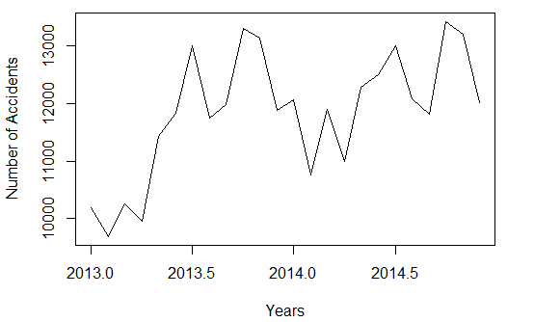
Time series model
Model evaluation:
Modified test set:

Slide 39
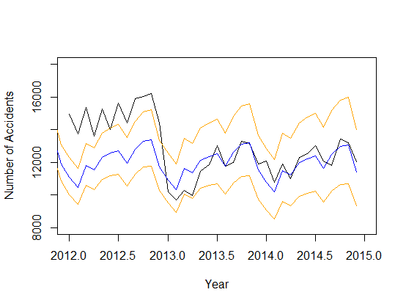
Time series model
Model evaluation:
Model accuracy on original test set:

Slide 40
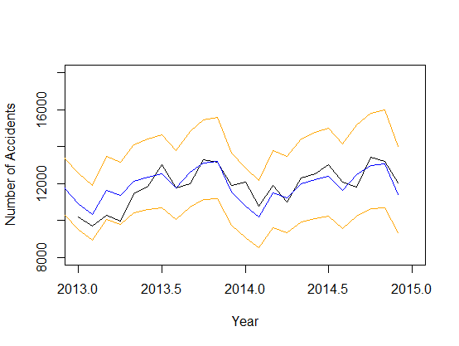
Time series model
Model evaluation:
Model accuracy on modified test set:

Slide 41
Time series model
Model evaluation:
Using both test sets, the accuracy of the model when tested on modified test set is much higher, and the error significantly decreased. So, we can conclude that using accurate test set gives better and more accurate results.

Slide 42
Severity prediction model
This model goal is to predict severity of the accident based on some accident information. Severity has 3 values: 1 = Fatal, 2 = Serious and 3 = Slight.
Three trials were done by three different classifiers:
1- Naïve Bayes Classifier - as the features affecting the severity are categorical not continuous.
2- Neural Networks – using nnet package.
3- Random forest.

Slide 43
Severity prediction model
We noticed that the accuracy is not high in any model even after fixing the unbalanced dataset issue so this might be due to non-effectiveness of the features in the data itself.
Also , the training set accuracy isn’t high , this is an under-fitting case due to the high bias and the non-effectiveness of the features in the data itself , which makes the model miss the relevant relations between features and target output .

Slide 44
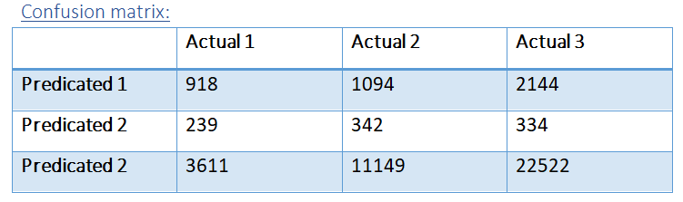
Severity prediction model
Model evaluation:
We will evaluate each model by tabulating the confusion matrix and calculating its accuracy.
Naïve Bayes Classifier:
Training set:
Accuracy:
Accuracy of the training set is equal to 56.53 %.

Slide 45
Severity prediction model
Model evaluation:
Test set:
Accuracy:
Accuracy of the testing set is equal to 56.15 %.
Precision:
Precision c1: (918)/(918+1094+2144)=22%
Precision c2: (241)/(239+342+334)=37.4%
Precision c3: (22522)/(11149+22522+3611)=82.5%
Overall precision: (82.5+37.4+22)/3=47.3%
Recall:
Recall c1: (918)/(918+239+3611)=19.3%
Recall c2: (342)/(342+1094+11149)=2.7%
Recall c3: (22522)/(334+2144+22522)=91.3%

Slide 46
Severity prediction model
Model evaluation:
Comments:
The accuracy is low, it is biased towards class 3 and this is obvious by the percentage of Recall of c3 which means that the data is classified as c3 91% of the time .
Due to the issues discussed above, we tried to increase accuracy by using Neural Networks.

Slide 47
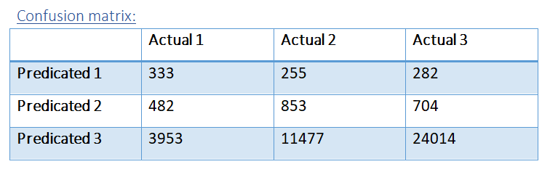
Severity prediction model
Model evaluation:
Neural networks:
We monitored the performance and the best one was at decay = 0.2 and iterations = 300 .
Training set:
Accuracy:
Accuracy of the training set is equal to 56.53 %.

Slide 48
Severity prediction model
Model evaluation:
Comments:
The accuracy is slightly better than that given by the Naïve Bayes Classifier.
We trained the model as following :
modelNN<-nnet(as.factor(Accident_Severity)~Number_of_Vehicles +Day_of_Week+X1st_Road_Class+Road_Type+Speed_limit+
X2nd_Road_Class+Road_Surface_Conditions,data=training,size =8 ,decay = 0.2,maxit = 300)
We used the decay as 0.2, we compromised it not be very low so it won’t converge slowly and not very high so it won’t oscillate around local minima .
For the number of iterations, if we extend it to 700-1000 or decrease it to 100-150 it gives lower accuracy .
The size is the number of the neurons of the hidden layer , the default in the nnet package is 1 hidden layer and the size is left to be decided ;6-8 gives good performance .

Slide 49
Severity prediction model
Model evaluation:
Test set:
Accuracy:
Accuracy of the testing set is equal to 59.5 %.
Precision:
Precision c1: (333)/(333+255+282)=38.2%
Precision c2: (853)/(853+482+704)=41.8%
Precision c3: (24014)/(24014+11477+3953)=40.3%
Overall precision: (38.2+41.8+40.3)/3=40.1%
Recall:
Recall c1: (333)/(333+482+3953)=7%
Recall c2: (853)/(853+255+11477)=7 %
Recall c3 is a very large value .

Slide 50
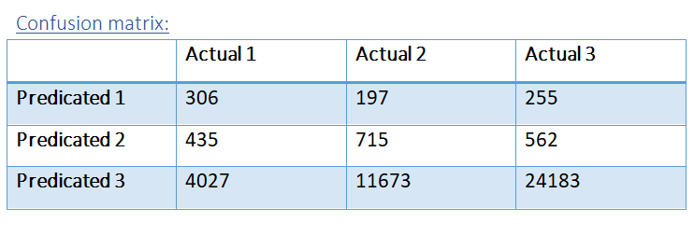
Severity prediction model
Model evaluation:
Random forest:
We monitored the performance and the best one was at decay = 0.2 and iterations = 300 .
Training set:
Accuracy:
Accuracy of the training set is equal to 60 %.

Slide 51
Severity prediction model
Model evaluation:
Test set:
Accuracy:
Accuracy of the testing set is equal to 59.51%.
Precision:
Precision c1: (306)/(306+197+255)=40.36%
Precision c2: (715)(715+435+562)=41.8%
Precision c3: (24183)/(24183+11673+4027)=60.6%
Overall precision: (82.5+37.4+22)/3=47.5
Recall:
Recall c1: (306)/(306+435+4027)=6.4%
Recall c2: (715)/(715+197+11673)=2.7%
Recall c3: (24183)/(24183+562+255)=96.7%

Slide 52
Severity prediction model
Model evaluation:
Comments:
The accuracy , Precision and recall are still almost the same as the neural network model .

Slide 53
References
Dataset:
https://www.kaggle.com/daveianhickey/2000-16-traffic-flow-england-scotland-wales?fbclid=IwAR0dGYRO__sdeIfxN0T-2pLgnHB2wYj1A3IY23ix5siPDjMO4-GvUYDP5QU

